Slide 1
Reminders
HW10 on Neural Machine Translation Or Milestone 2 is Due on Wednesday.
Quiz on Chapter 18 and 20 (IE and SRL) is due tonight at midnight.

Slide 2
Review: Machine Translation

Slide 3
Machine Translation
Translation from one language to another
I'm giving a talk at University of Pennsylvania
ペンシルベニア大学で講演をしています。

Slide 4
Machine Translation
Translation from one language to another
ペンシルベニア大学で講演をしています。
I'm giving a talk at University of Pennsylvania

Slide 5
Conditional Language Models
Not just generate text, generate text according to some specification
Input X
Output Y (Text)
Task
Structured Data
NL Description
NL Generation
English
Japanese
Translation
Document
Short Description
Summarization
Utterance
Response
Response Generation
Image
Text
Image Captioning
Speech
Transcript
Speech Recognition

Slide 6
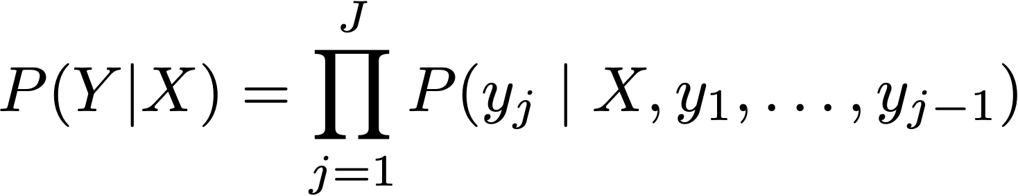
Conditional Language Models
Added Context!

Slide 7




Review: Encoder-Decoder MT
Encoder
kono
eiga
ga
kirai
</s>
LSTM
LSTM
LSTM
LSTM
LSTM
I
hate
this
movie
LSTM
LSTM
LSTM
LSTM
argmax
argmax
argmax
argmax
argmax
I
hate
this
movie
</s>
Decoder
Sutskever et al. 2014

Slide 8
Review: Encoder-Decoder MT
MT is the task of automatically translating sentences from one language into another.
We use bilingual parallel texts to train MT systems – pairs of source-target sentences that are translations of each other.
To extend LMs and autoregressive generation to MT, we will:
Add an end-of-sentence marker to each source sentence. Concatenate the target sentence to it.
Train an RNN LM based on this combined data.
To translate, simply treat the input sentence as a prefix, create a hidden state representation for it (encoding step).
Use the hidden state produced by the encoder to then start generating (decoding step)
Notes:
To translate a source text using the trained model, we run it through the network performing forward inference to generate hidden states until we get to the end of the source. Then we begin autoregressive generation, asking for a word in the context of the hidden layer from the end of the source input as well as the end-of-sentence marker. Subsequent words are conditioned on the previous hidden state and the embedding for the last word generated.

Slide 9
Evaluating MT Quality

Slide 10
Evaluating MT Quality
Why do we want to do it?
Want to rank systems
Want to evaluate incremental changes
What to make scientific claims
How not to do it
“Back translation”
The vodka is not good

Slide 11
Human Evaluation of MT v. Automatic Evaluation
Human evaluation is
Ultimately what we're interested in, but
Very time consuming
Not re-usable
Automatic evaluation is
Cheap and reusable, but
Not necessarily reliable

Slide 12
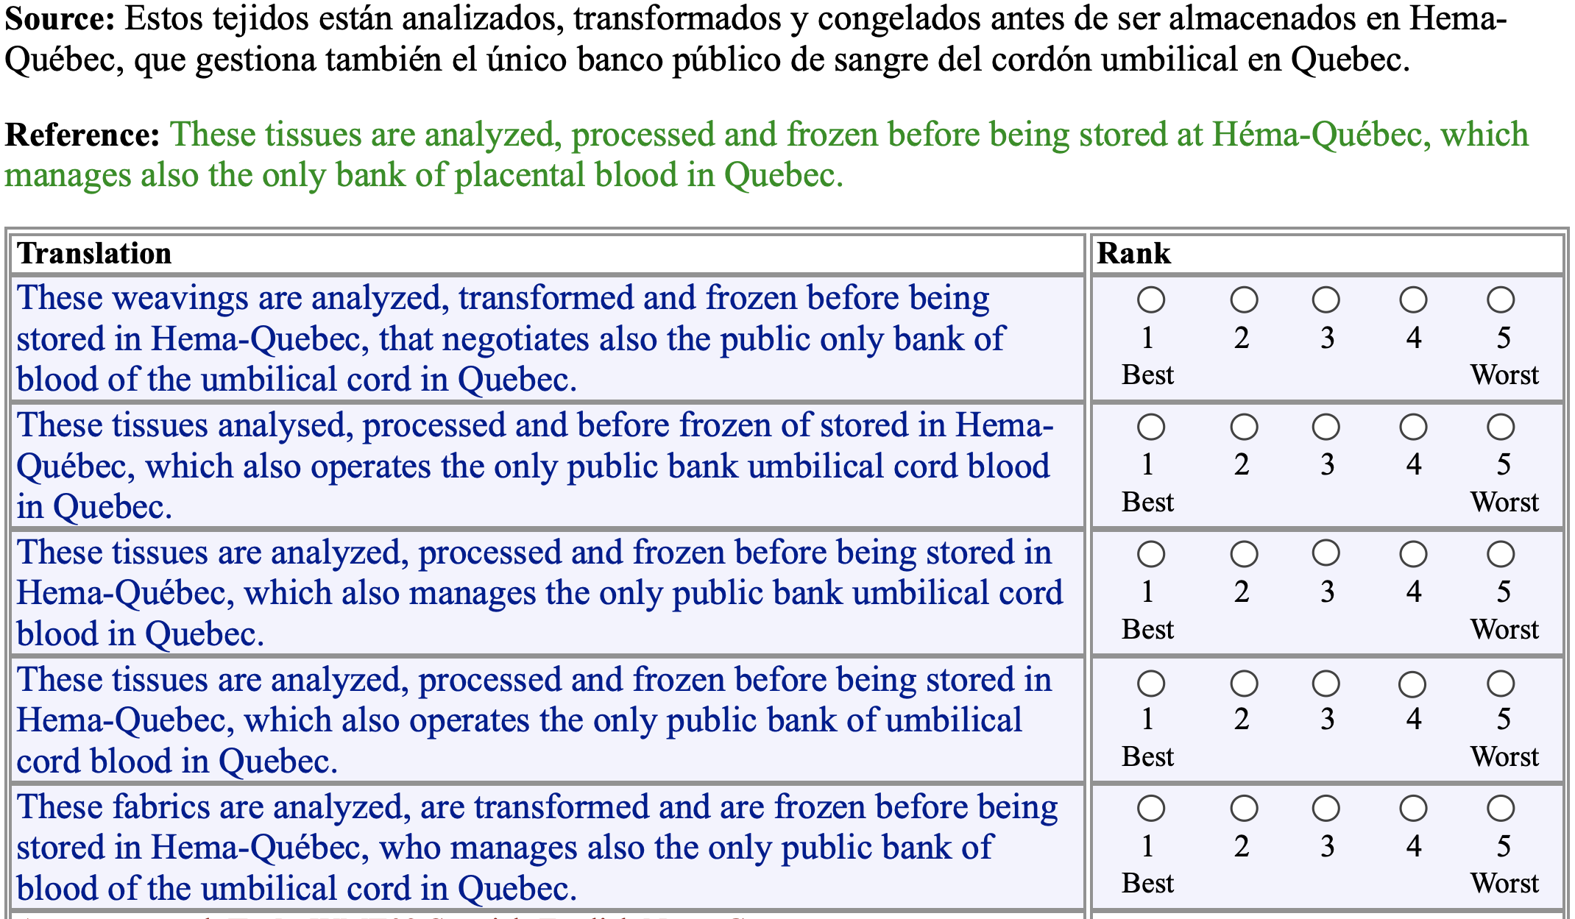
Manual Evaluation

Slide 13
Goals for
Automatic Evaluation
No cost evaluation for incremental changes
Ability to rank systems
Ability to identify which sentences we're doing poorly on, and categorize errors
Correlation with human judgments
Interpretability of the score

Slide 14
Methodology
Comparison against reference translations
Intuition: closer we get to human translations, the better we're doing
Could use WER like in speech recognition?

Slide 15
Word Error Rate
Levenshtein Distance (also known as "edit distance")
Minimum number of insertions, substitutions, and deletions needed to transform one string into another
Useful measure in speech recognition
This shows how easy it is to recognize speech
This shows how easy it is to wreck a nice beach
Notes:
Unlike translation, speech recognition is easy

Slide 16
Problems with WER
Unlike speech recognition we don't have the assumption of exact match against the reference or linearity
In MT there can be many possible (and equally valid) ways of translating a sentence, and phrases can be rearranged.
Notes:
Different words can be used

Slide 17
Solutions
/
Compare against lots of test sentences
1
Use multiple reference translations for each test sentence
2
Look for phrase / n-gram matches, allow movement
3

Slide 18
BLEU
BiLingual Evaluation Understudy
Uses multiple reference translations
Look for n-grams that occur anywhere in the sentence

Slide 19
Multiple references
Ref 1 | Orejuela appeared calm as he was led to the American plane which will take him to Miami, Florida.
Ref 2 | Orejuela appeared calm while being escorted to the plane that would take him to Miami, Florida.
Ref 3 | Orejuela appeared calm as he was being led to the American plane that was to carry him to Miami in Florida.
Ref 4 | Orejuela seemed quite calm as he was being led to the American plane that would take him to Miami in Florida.

Slide 20
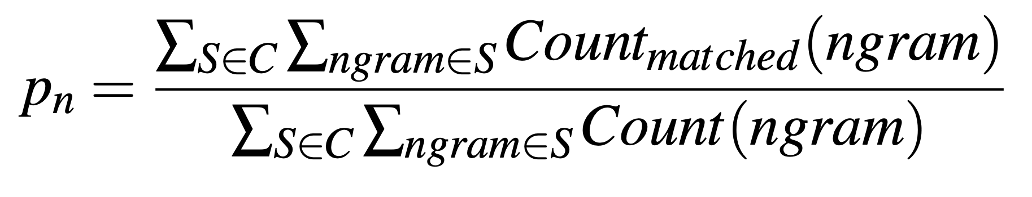
n-gram precision
BLEU modifies this precision to eliminate repetitions that occur across sentences.

Slide 21
Multiple references
Ref 1 | Orejuela appeared calm as he was led to the American plane which will take him to Miami, Florida.
Ref 2 | Orejuela appeared calm while being escorted to the plane that would take him to Miami, Florida.
Ref 3 | Orejuela appeared calm as he was being led to the American plane that was to carry him to Miami in Florida.
Ref 4 | Orejuela seemed quite calm as he was being led to the American plane that would take him in Florida. to Miami
“to Miami” can only be counted as correct once

Slide 22
Ref 1 | Orejuela appeared calm as he was led to the American plane which will take him to Miami, Florida.
Ref 2 | Orejuela appeared calm while being escorted to the plane that would take him to Miami, Florida.
Ref 3 | Orejuela appeared calm as he was being led to the American plane that was to carry him to Miami in Florida.
Ref 4 | Orejuela seemed quite calm as he was being led to the American plane that would take him to Miami in Florida.
Hyp | appeared calm when he was taken to the American plane, which will to Miami, Florida.

Slide 23
American, Florida, Miami, Orejuela, appeared, as, being, calm, carry, escorted, he, him, in, led, plane, quite, seemed, take, that, the, to, to, to, was , was, which, while, will, would, ,, .
1-gram precision = 15/18
Hyp | appeared calm when he was taken to the American plane , which will to Miami , Florida .

Slide 24
American plane, Florida ., Miami ,, Miami in, Orejuela appeared, Orejuela seemed, appeared calm, as he, being escorted, being led, calm as, calm while, carry him, escorted to, he was, him to, in Florida, led to, plane that, plane which, quite calm, seemed quite, take him, that was, that would, the American, the plane, to Miami, to carry, to the, was being, was led, was to, which will, while being, will take, would take, , Florida
2-gram precision = 10/17
Hyp | appeared calm when he was taken to the American plane , which will to Miami , Florida .

Slide 25
n-gram precision
Hyp | appeared calm when he was taken to the American plane, which will to Miami, Florida.
1-gram precision = 15/18 = .83
2-gram precision = 10/17 = .59
3-gram precision = 5/16 = .31
4-gram precision = 3/15 = .20
Geometric average
(0.83 * 0.59 * 0.31 * 0.2)^(1/4) = 0.417
or equivalently
exp(ln .83 + ln .59 + ln .31 + ln .2/4) = 0.417

Slide 26
Ref 1 | Orejuela appeared calm as he was led to the American plane which will take him to Miami, Florida.
Ref 2 | Orejuela appeared calm while being escorted to the plane that would take him to Miami, Florida.
Ref 3 | Orejuela appeared calm as he was being led to the American plane that was to carry him to Miami in Florida.
Ref 4 | Orejuela seemed quite calm as he was being led to the American plane that would take him to Miami in Florida.
Hyp | to the American plane

Slide 27
Is this better?
Hyp | to the American plane
1-gram precision = 4/4 = 1.0
2-gram precision = 3/3 = 1.0
3-gram precision = 2/2 = 1.0
4-gram precision = 1/1 = 1.0
exp(ln 1 + ln 1 + ln 1 + ln 1) = 1
Notes:
precision = correct / output-length
recall = correct / reference-length

Slide 28
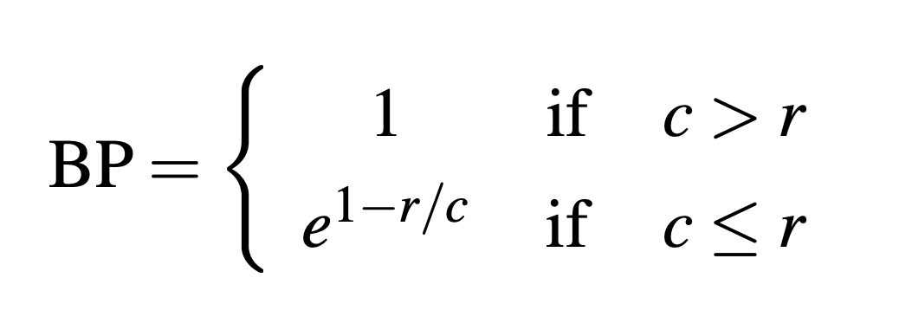
Brevity Penalty
c is the length of the corpus of hypothesis translations
r is the effective reference corpus length
The effective reference corpus length is the sum of the single reference translation from each set that is closest to the hypothesis translation.

Slide 29
Brevity Penalty
MT is Longer
MT is Shorter
Difference with effective reference length (%)

Slide 30
Ref 1 | Orejuela appeared calm as he was led to the American plane which will take him to Miami, Florida.
r = 20
Hyp | appeared calm when he was taken to the American plane, which will to Miami, Florida.
c = 18
BP = exp(1-(20/18)) = 0.89
Ref 1 | Orejuela appeared calm as he was led to the American plane which will take him to Miami, Florida.
r = 20
Hyp | to the American plane
c = 4
BP = exp(1-(20/4)) = 0.02

Slide 31
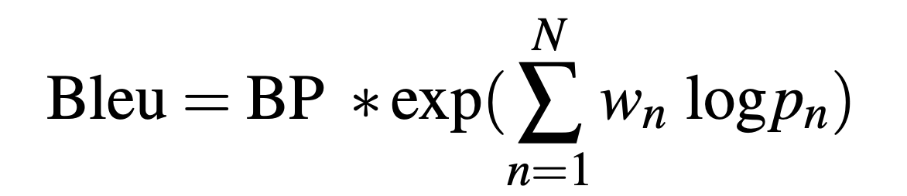
BLEU
Geometric average of the n-gram precisions
Optionally weight them with w
Multiplied by the brevity penalty
Notes:
exp = Exponent function = e^x

Slide 32
BLEU
Hyp | appeared calm when he was taken to the American plane, which will to Miami, Florida.
exp(1-(20/18)) * exp((ln .83 + ln .59 + ln .31 + ln .2)/4) = 0.374
Hyp | to the American plane
exp(1-(20/4)) * exp((ln 1 + ln 1 + ln 1 + ln 1)/4)
= 0.018

Slide 33
Problems with BLEU
Synonyms and paraphrases are only handled if they are in the set of multiple reference translations
The scores for words are equally weighted so missing out on content-bearing material brings no additional penalty.
The brevity penalty is a stop-gap measure to compensate for the fairly serious problem of not being able to calculate recall.

Slide 34
More Metrics
WER - word error rate
PI-WER - position independent WER
METEOR - Metric for Evaluation of Translation with Explicit ORdering
TERp - Translation Edit Rate plus

Slide 35
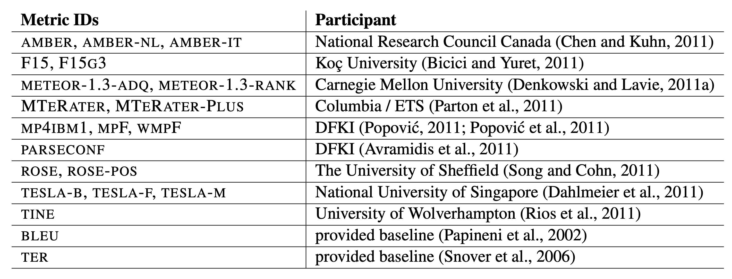
Even More Metrics

Slide 36
How do we know which metric is best?
Measure correlation with human judgments
How do people evaluation MT quality

Slide 37
Manual Evaluation

Slide 38
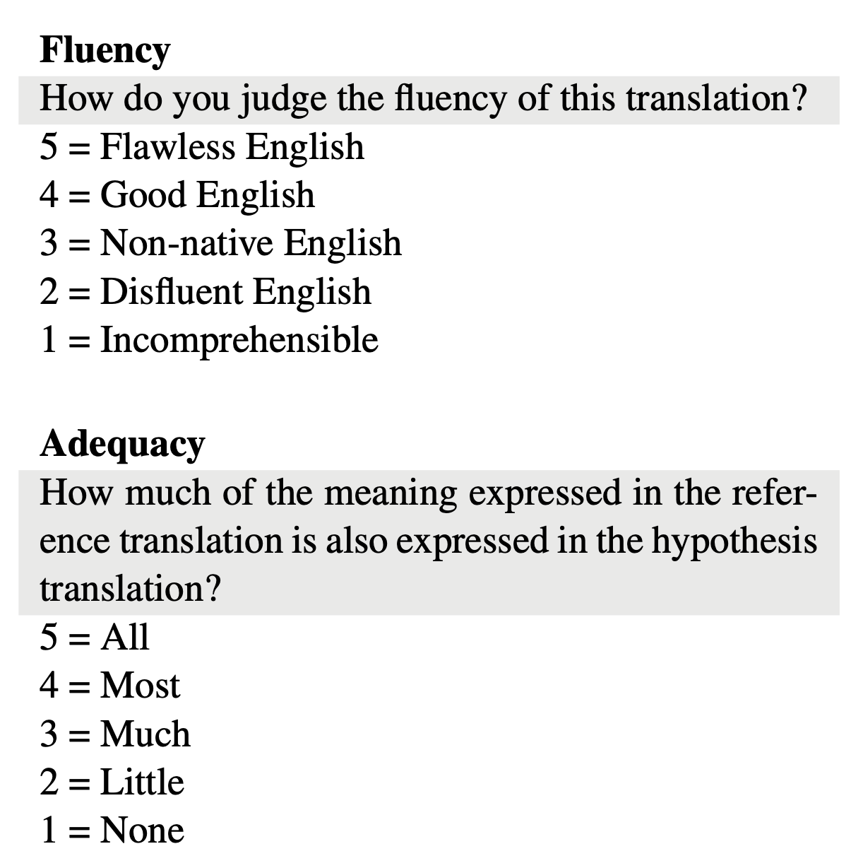
5-point scales

Slide 39
Basic Evaluation Paradigm
Use parallel test set
Use system to generate translations
Compare target translations w/ reference

Slide 40
Human Evaluation
Ask a human to do evaluation
Final goal, but slow, expensive, and sometimes inconsistent

Slide 41
BLEU
Works by comparing n-gram overlap w/ reference
Pros: Easy to use, good for measuring system improvement
Cons: Often doesn’t match human eval, bad for comparing very different systems

Slide 42
Other Options
METEOR: Considers synonyms
Translation Edit Rate (TER): Considers number of edits to be turned into a good translation
chrF: Considers score on the character level
RIBES: Considers reordering
etc. etc.

Slide 43
Cross-lingual Word Representations
Notes:
Thanks to Shyam Upadhyay for many of the slides today. Shyam graduated from Upenn in 2019 and is now working on multilingual things at Google.
Cross-lingual Models of Word Embeddings: An Empirical Comparison by Shyam Upadhyay, Manaal Faruqui, Chris Dyer, Dan Roth

Slide 44
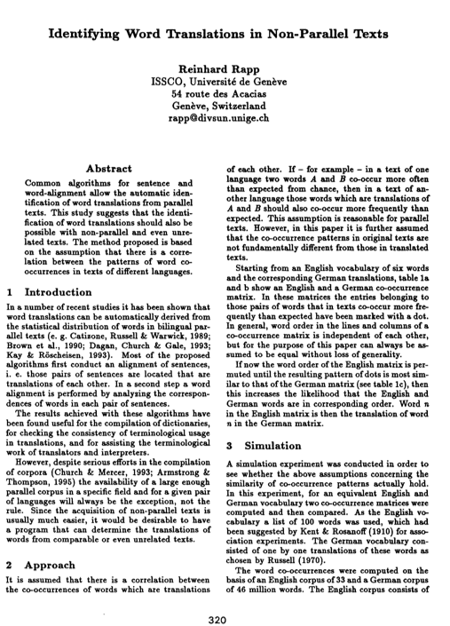
Goal
Learn the translations of individual words without large bilingual parallel corpora
ACL 1995
Egypt 196BC

Slide 45
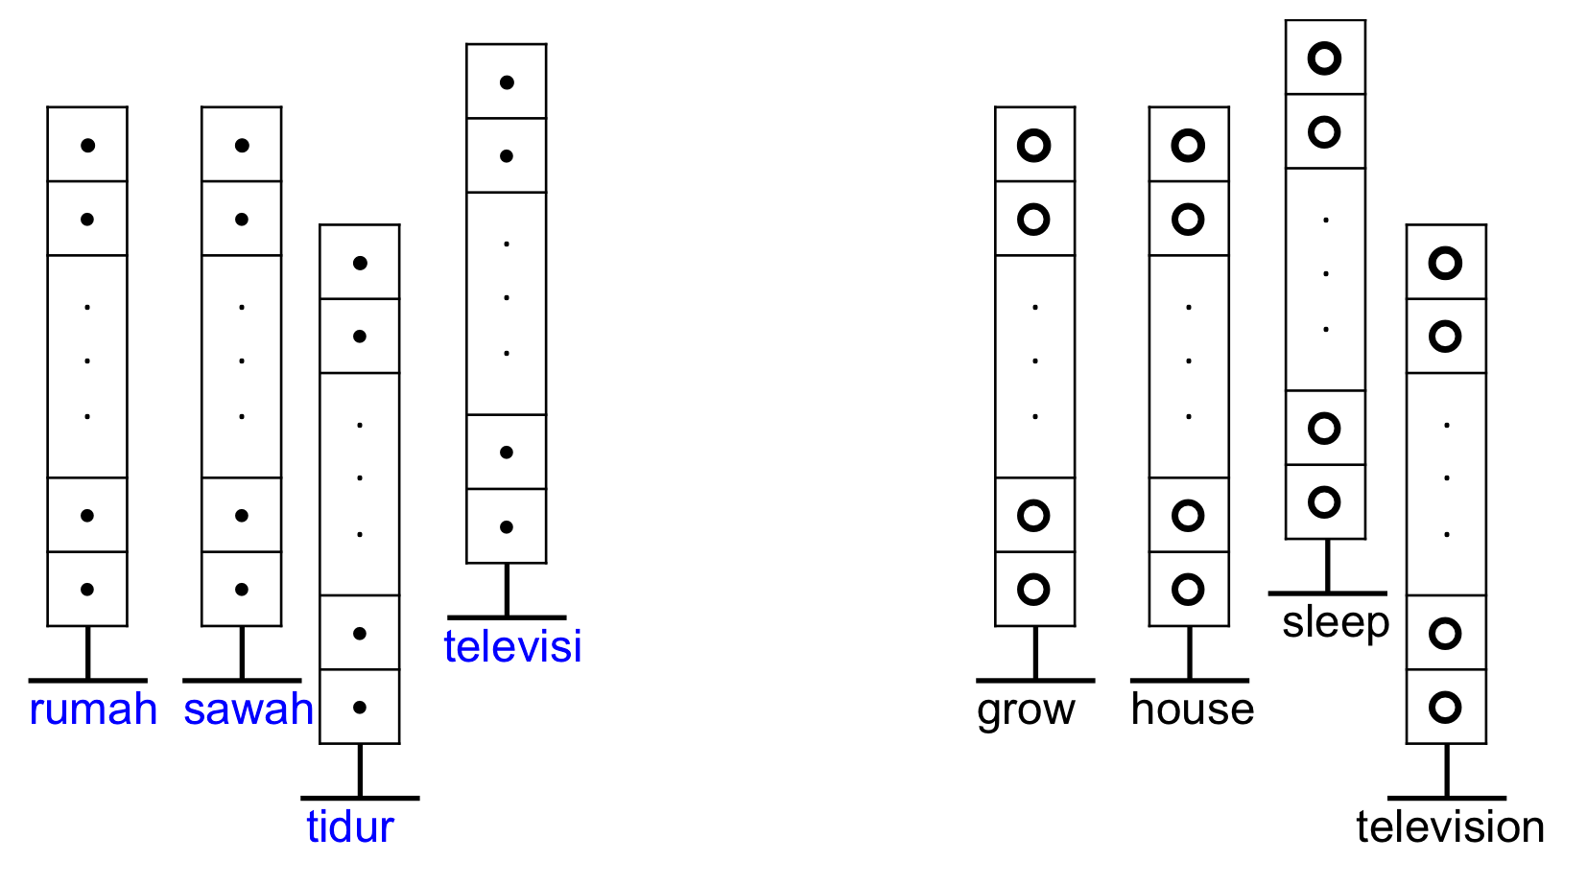
Translations from monolingual texts
Word embeddings have been shown to be useful for many natural language processing tasks. Can we use these vector space models to learn translations for rare words?

Slide 46
Monolingual Word Embeddings
Monday
cat
Friday
dog
Baltimore

Slide 47
Monolingual Word Embeddings
kucing
anjing
Baltimore
Monday
cat
Friday
dog
Baltimore
senen
jumat

Slide 48
Bilingual Word Embeddings
cat
kucing
Monday
senen
anjing
Friday
dog
jumat
baltimore
Baltimore

Slide 49
Projecting Vector Space Models

Slide 50
Projecting Vector Space Models

Slide 51
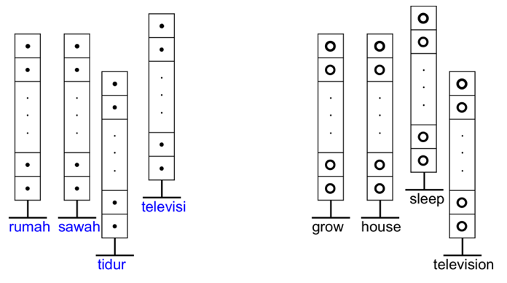
Word Embeddings
Instead of high dimensional vector space models used by Rapp and others in the past, we use low-dimensional word embeddings.

Slide 52
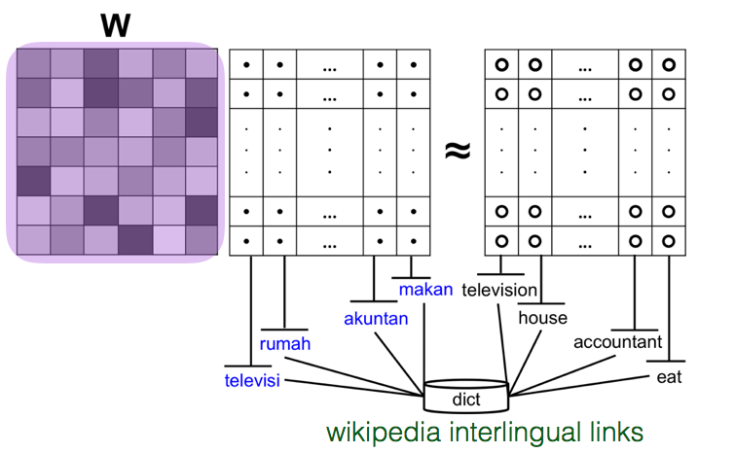
Learning Bilingual Embeddings
mapping function W
Notes:
Goal learn a mapping function W that maps the target language vectors in the seed translations to their corresponding souce language vectors.

Slide 53
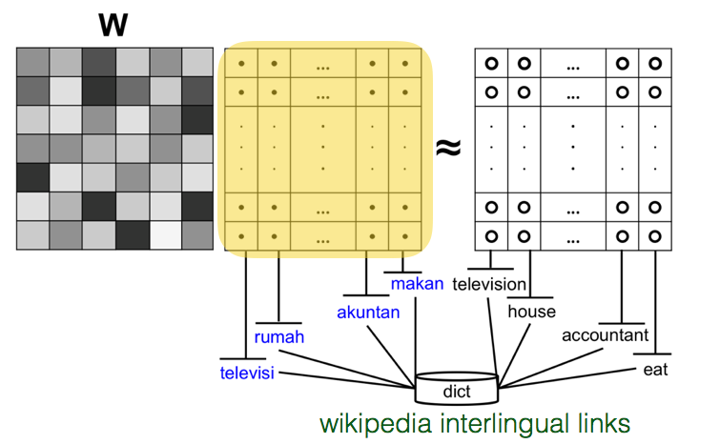
Learning Bilingual Embeddings
matrix of source language embeddings
Notes:
When we apply W to the matrix of source language embeddings, then the result should be close to the matrix of target language embeddings

Slide 54
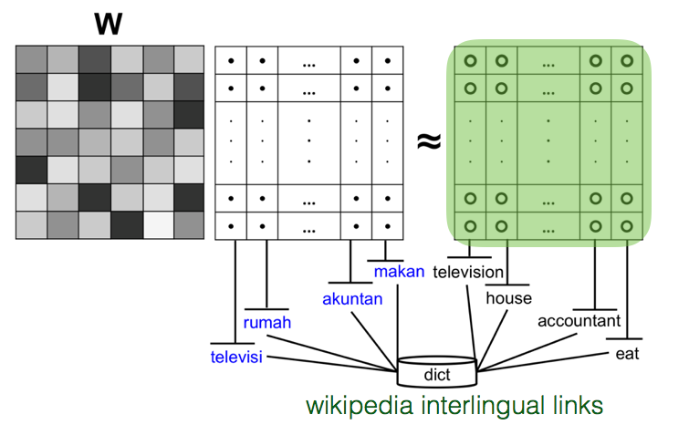
Learning Bilingual Embeddings
matrix of target language embeddings
Notes:
When we apply W to the matrix of source language embeddings, then the result should be close to the matrix of target language embeddings

Slide 55
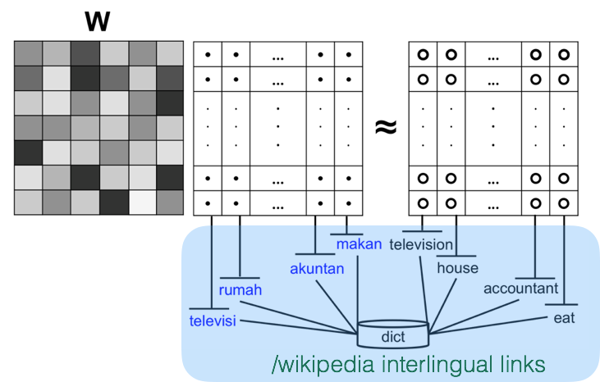
Learning Bilingual Embeddings
bilingual dictionaries or Wikipedia inter-language links
Notes:
In order to learn the mapping function, we use our crowdsourced dictionaries and other information like Wikipedia inter-language links that gives the correspondence between a small number of source and target words.

Slide 56
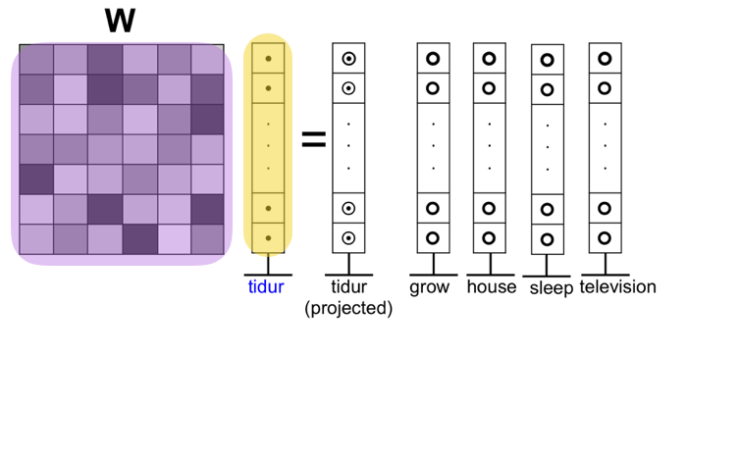
Learning Bilingual Embeddings
Apply W to a source language embedding
Notes:
Then when we want to find the translations of a new source language word, that wasn’t in our bilingual resources, we apply W to its word embedding to project it into the target language space.

Slide 57
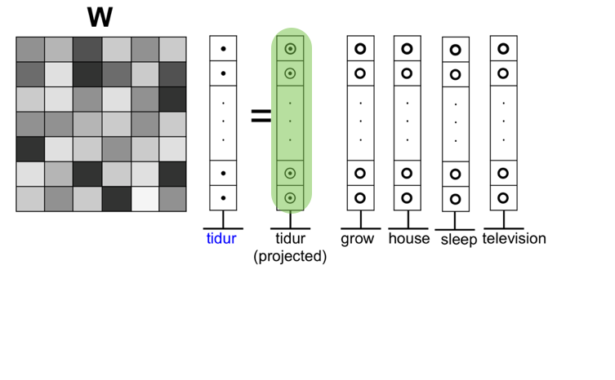
Learning Bilingual Embeddings
Project it into the target language space
Notes:
Then when we want to find the translations of a new source language word, that wasn’t in our bilingual resources, we apply W to its word embedding to project it into the target language space.

Slide 58
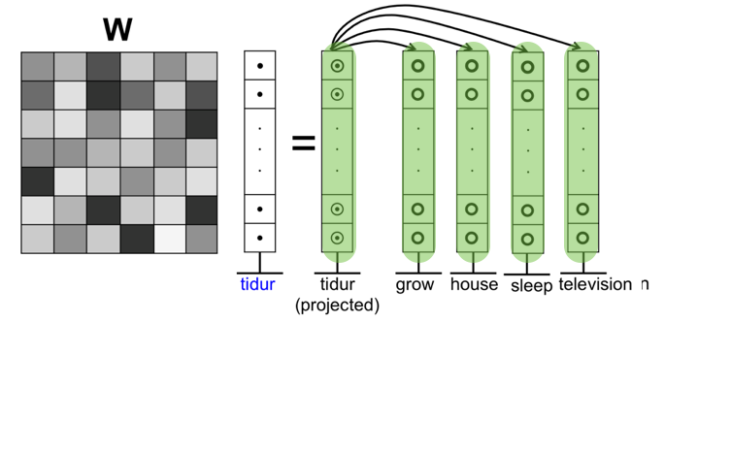
Learning Bilingual Embeddings
Compare against all target language embeddings use nearest neighbors as translations
Notes:
We can compare the projected vector against all of the embeddings in the target language, using cosine similarity, and come up with the k-nearest neighbors as potential translations.

Slide 59
Example Translations for Indonesian
mediterania | pertumbuhannya | solusi | pagar | armada
mediterranean | growth | solutions | fence | armada
aegean | exponentially | solver | tail | fleet
atlantic | germination | alternatives | fences | ships
baltic | rapidly | solving | info | warships
levantine | regrowth | bootstrapping | perimeter | freighter
europe | thrive | solution | biography | tanker
adriatic | /year | objective | around | oiler
pacific | growing | problem | moat | lst
marmara | steadily | enabler | embankment | frigate
caribbean | stunted | solvers | clothing | squadron
Notes:
Here are some example translations that are learned for a few of Indoenesian words in our test set. We compare these against 100,000 English words, where the translation is guaranteed to be found among them. Not a completely realistic task, but not too bad. We are currently finding a correct translation within the top 10 for about 70% of our test words.

Slide 60
Ways to learn W
Linear Mapping
Neural Net
Matrix Factorization with Bayesian Personalized Ranking
Full details in Wijaya et al (EMNLP 2017)
Derry Wijaya’s postdoc was funded by LORELEI. She is now an assistant professor at Boston University.

Slide 61
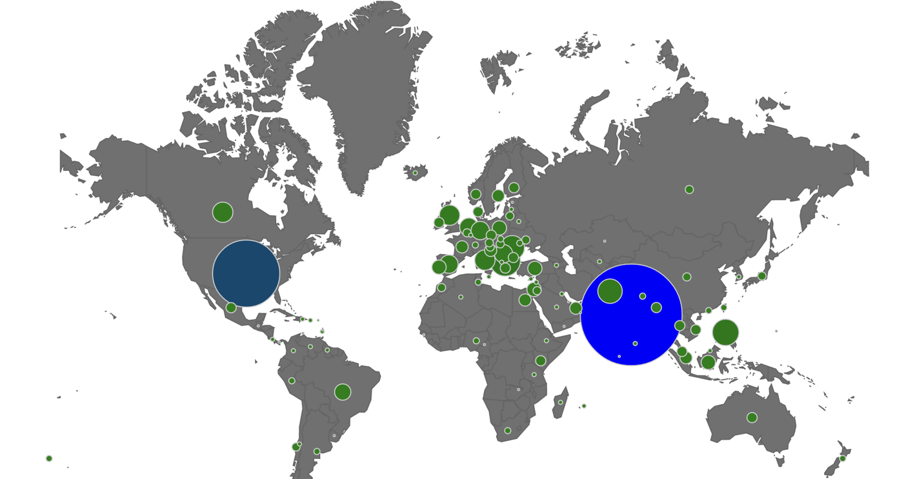
Bilingual Dictionaries
We need seed bilingual dictionaries to learn the mapping between source and target language embeddings.
We previously created bilingual dictionaries via crowdsourcing between English and 100 other languages.
Derry tested her models on more than 2 dozen high and low resource languages.
Full details in Pavlick et al (TACL 2014)
Notes:
Albanian, Amharic, Arabic, Armenian, Asturian, Azerbaijani, Basque, Belarusian, Bengali, Bishnupriya Manipuri, Bosnian, Breton, Bulgarian, Catalan, Cebuano, Central Bicolano, Chinese, Croatian, Czech, Danish, Dutch, Esperanto, Finnish, French, Galician, Georgian, German, Greek, Gujarati, Haitian, Hebrew, Hindi, Hungarian, Icelandic, Ilokano, Indonesian, Irish, Italian, Japanese, Javanese, Kannada, Kapampangan, Korean, Kurdish, Latvian, Lithuanian, Low Saxon, Luxembourgish, Macedonian, Malagasy, Malay, Malayalam, Marathi, Neapolitan, Nepali, Newar / Nepal Bhasa, Norwegian, Pashto, Persian, Piedmontese, Polish, Portuguese, Punjabi, Romanian, Russian, Serbian, Serbo-Croatian, Sicilian, Sindhi, Slovak, Slovenian, Somali, Spanish, Sundanese, Swahili, Swedish, Tagalog, Tamil, Telugu, Thai, Tibetan, Turkish, Ukrainian, Urdu, Uzbek, Vietnamese, Waray-Waray, Welsh, West Frisian, Wolof, Yoruba, Zazaki

Slide 62
Efficient Manipulation of Word Handling Vectors
We developed Magnitude, a blazingly fast Python utility for vector embeddings that performs common operations up to 60 to 6,000 times faster than Gensim.
Full details in Patel, Sands et al (EMNLP 2018)
Penn undergrads Ajay Patel and Alex Sands founded an NLP startup company, Plasticity.ai, which now has 2 SBIR contracts with AFRL.

Slide 63
Integration into NMT
The HLTCOE hosted a SCALE summer workshop on domain adaptation for Neural Machine Translation.
Different domains have different language use patterns and vocabulary.
Politicians are strange creatures that have very strange breeding habits
The invention relates to a separation unit (1) for separating salts from a detergent, comprising a crystalliser (3) with a crystallisation chamber

Slide 64
Translating OOVs
Our LORELEI bilingual embeddings algorithms were used to translate out of vocabulary items.
الالومينوم | اسعل | استجابتك | اعلاما | الاذونات
alumina | burping | alertness | banners | approvals
aluminium | coughs | attentiveness | flag | authorisations
aluminum | farts | audibly | flagpoles | authorization
cement | louder | prompt | flags | authorizations
ferrous | panting | respond | “have | contracts
magnesium | sneeze | responding | mottoes | copyrights
oxide | sneezing | response | proudly | exemptions
plastics | squeals | responsiveness | salute | licences
polysilicon | whine | sensitivity | salutes | licenses
wallboard | whining | urge | universally | permissions

Slide 65
Manual Evaluation
We asked linguists to evaluate the quality of top-10 predicted translations for OOV words. They judged between 1000-5000 translations.
Language | Top 10 accuracy
Arabic | 55%
Farsi | 51%
Korean | 26%
Chinese | 22%

Slide 66
Integration into NMT
Currently working on more direct integration of pre-trained bilingual embeddings into NMT.
Along they way, we are improving decoding models generally.
See our upcoming ACL 2019 paper Comparison of Diverse Decoding Methods from Conditional Language Models.

Slide 67
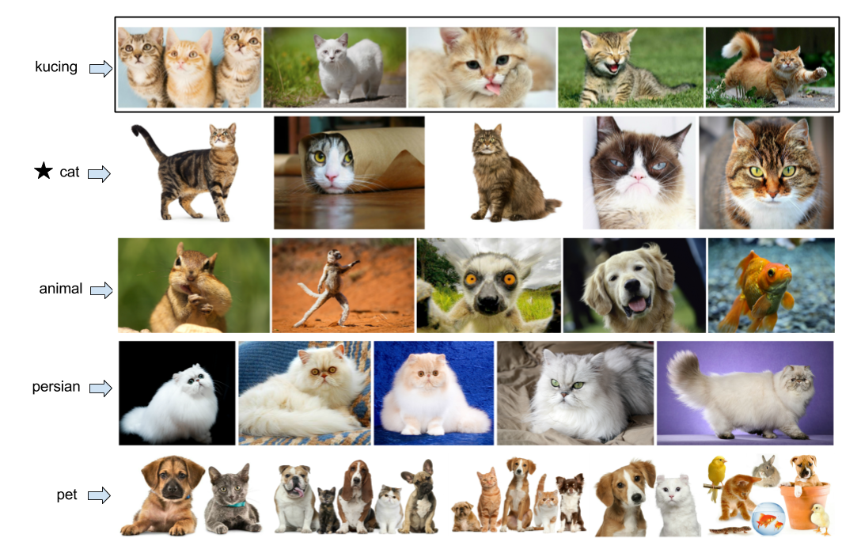
Can we use images instead of bilingual dictionaries?

Slide 68
Massively Multilingual Image Dataset (MMID)
100 languages, 10,000 words per language, plus 250K English word translations
100 images per word, 35M images, plus text of web pages they appeared on (20TB of data)
Hosted by Amazon Public Datasets
multilingual-images.org
Full details in Hewitt, Ippolito et al (ACL 2018)
Notes:
Our team has attempted this at a much, much larger scale. We look at translation between English and 100 foreign languages. Instead of just nouns, we attempt to translate 10,000 words in each language of all different parts of speech. We crawled Google Image search and got 35M images - which is 21 TERABYTES of data.

Slide 69
Image-based Translation
Previous papers have tried to learn translations based on visual similarity of images.
Bergsma and Van Durme (2011) used SIFT+Histogram features
Kiela et al (2015) used Convolutional Neural Network features
They focused on translating nouns in high resource languages.
Notes:
Previous research has attempted this, by collecting images representing words in English and in foreign languages, and then mapping them onto vectors - for instance with CNNs. However, this past research focused only on a few high resource languages, and only attempted to discover translation of nouns.

Slide 70
New multilingual image corpus
We collect images for the 100 bilingual dictionaries created by Pavlick et al (2014)
100 languages, 10,000 words per language, ~263K English word translations (all POS)
We collected images with Google Image Search
100 images per word, 35M images, 21 TB of data
Notes:
Our team has attempted this at a much, much larger scale. We look at translation between English and 100 foreign languages. Instead of just nouns, we attempt to translate 10,000 words in each language of all different parts of speech. We crawled Google Image search and got 35M images - which is 21 TERABYTES of data.

Slide 71
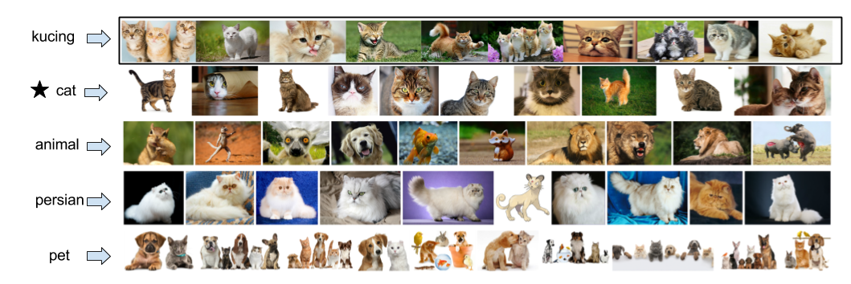
Example translations
Top 4 English translations for Indonesian word kucing by finding k-NN English images using CNN vectors
Notes:
Here’s an example of the top 4 English translations of the Indonesian word for cat, using just visual similarity.

Slide 72
Accuracy of image-based translation
High resource languages
(average = .29)
Low resource languages
(average = .16)
Notes:
Here’s a qualitative evaluation for the top-10 accuracy across high and low resource langauges.

Slide 73
When does it work?
Nouns and adjectives translate better than verbs and adverbs
Abstract words translate poorly compared to concrete words
Most Concrete Words
tulip - 5.0
telescope - 5.0
elephant - 5.0
bedsheet - 5.0
strawberry - 5.0
Most Abstract Words
essentialness - 1.04
hope - 1.04
spirituality - 1.07
although - 1.07
possibility - 1.33
Notes:
For both high and low resource languages, nouns and adjectives tend to translate better than verbs and adverbs. But that’s not the whole story. Words that are more concrete translate better than words that are more abstract.

Slide 74
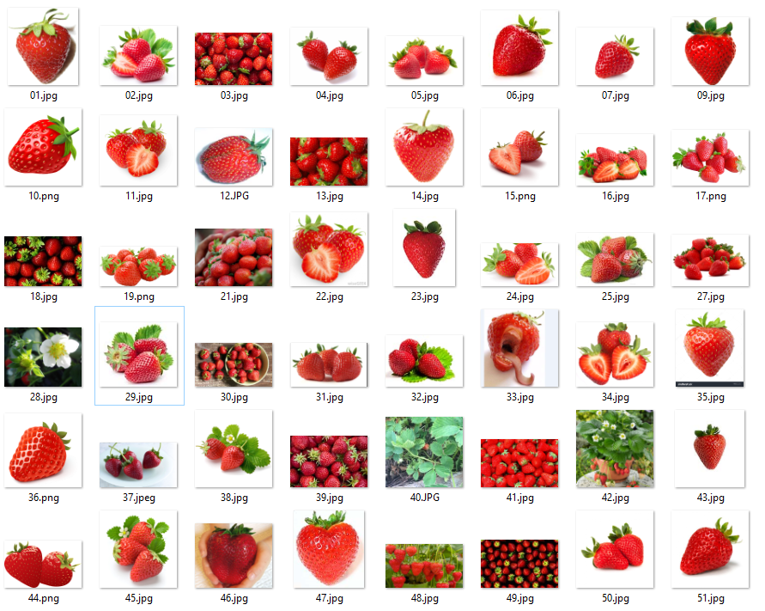
Concrete example
Notes:
Concrete words tend to be easy to represent visually.

Slide 75

Abstract example
Notes:
Abstract words, not so much.

Slide 76
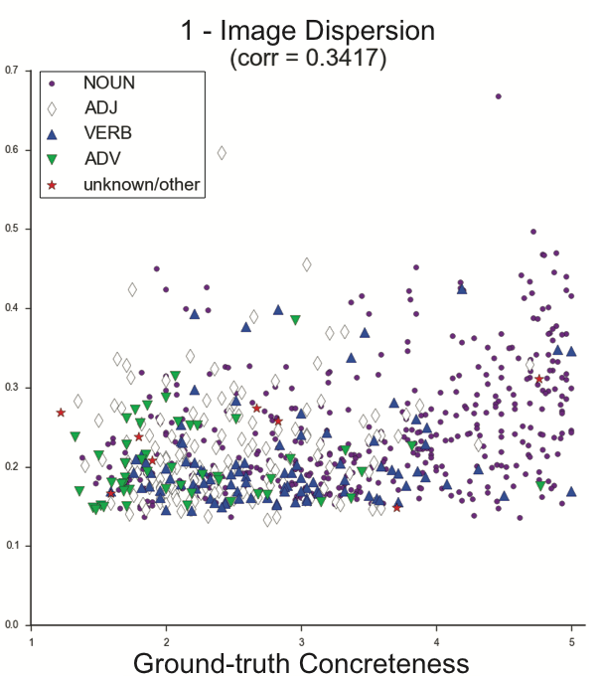
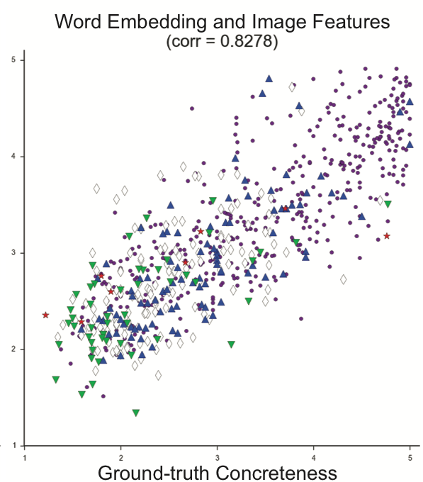
Can we predict concreteness?
Previous state of the art
Our method
Notes:
We built a model to predict the concreteness of a word based on its image features. We outperform the previous SOA for predicting concreteness.

Slide 77
We can produce better translations
Notes:
If we sort all of the vocabulary by our predicted concreteness score, and then only attempt to use image features to translate the top-k% most conncrete words, then we do quite well.

Slide 78
Mitigating Geographic Bias of Image Classifiers with MMID
Question: What’s wrong with these predictions?
Problem: ~75% of images in ImageNet are from Western countries.

Slide 79
Indian Weddings
Find images by translating wedding into Bengali, Bishnupriya-Manipuri, Gujarati, Hindi, Kannada, Malayalam, Marathi, Punjabi, Tamil, and Telugu
Notes:
Bengali, Bishnupriya-Manipuri, Gujarati, Hindi, Kannada, Malayalam, Marathi, Punjabi, Tamil, Telugu

Slide 80
Culturally Divergent Images
Work by Penn students Yoni Nachmany, Nikhil Krishnan, Aditya Kashyap

Slide 81
Culturally Divergent Images
Work by Penn students Yoni Nachmany, Nikhil Krishnan, Aditya Kashyap

Slide 82
References
Comparison of Diverse Decoding Methods from Conditional Language Models. Daphne Ippolito, Reno Kriz, Joao Sedoc, Maria Kustikova and Chris Callison-Burch. ACL 2019.
Magnitude: A Fast, Efficient Universal Vector Embedding Utility Package. Ajay Patel, Alex Sands, Marianna Apidianaki and Chris Callison-Burch. EMNLP 2018. Demo papers.
Learning Translations via Images with a Massively Multilingual Image Dataset. John Hewitt, Daphne Ippolito, Brendan Callahan, Reno Kriz, Derry Wijaya and Chris Callison-Burch. ACL 2018.
Learning Translations via Matrix Completion. Derry Wijaya, Brendan Callahan, John Hewitt, Jie Gao, Xiao Ling, Marianna Apidianaki and Chris Callison-Burch. EMNLP 2017.
A Comprehensive Analysis of Bilingual Lexicon Induction. Ann Irvine and Chris Callison-Burch. Computational Linguistics 2016.
The Language Demographics of Amazon Mechanical Turk. Ellie Pavlick, Matt Post, Ann Irvine, Dmitry Kachaev, and Chris Callison-Burch. TACL 2014.

